Slide 1
Stochastic Gradient Descent Algorithm

Slide 2
Basic Gradient Descent Algorithm
The gradient descent algorithm is an approximate and iterative method for mathematical optimization. You can use it to approach the minimum of any differentiable function.
Although gradient descent sometimes gets stuck in a local minimum or a saddle point instead of finding the global minimum, it’s widely used in practice.
machine learning methods often apply it internally to optimize model parameters. For example, neural networks find weights and biases with gradient descent.

Slide 3
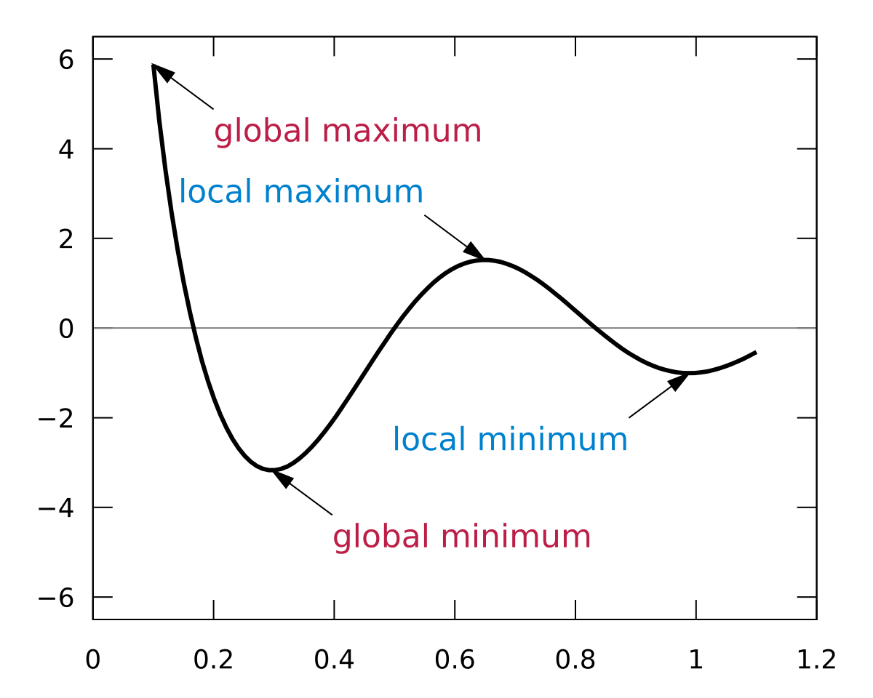
local and global minima

Slide 4
Cost Function: The Goal of Optimization
The cost function, or loss function, is the function to be minimized (or maximized) by varying the decision variables.
Many machine learning methods solve optimization problems under the surface.
ML alogrithms tend to minimize the difference between actual and predicted outputs by adjusting the model parameters (like weights and biases for neural networks, decision rules for random forest or gradient boosting, and so on).

Slide 5
Minimize errors in regression problems
In a regression problem, you typically have the vectors of input variables 𝐱 = (𝑥₁, …, 𝑥ᵣ) and the actual outputs 𝑦.
You want to find a model that maps 𝐱 to a predicted response 𝑓(𝐱) so that 𝑓(𝐱) is as close as possible to 𝑦.
For example, you might want to predict an output such as a person’s salary given inputs like the person’s number of years at the company or level of education.
Your goal is to minimize the difference between the prediction 𝑓(𝐱) and the actual data 𝑦. This difference is called the residual.

Slide 6
Minimize errors in regression problems
In this type of problem, you want to minimize the sum of squared residuals (SSR), where SSR = Σᵢ(𝑦ᵢ − 𝑓(𝐱ᵢ))² for all observations 𝑖 = 1, …, 𝑛, where 𝑛 is the total number of observations. Alternatively, you could use the mean squared error (MSE = SSR / 𝑛) instead of SSR.
Both SSR and MSE use the square of the difference between the actual and predicted outputs. The lower the difference, the more accurate the prediction. A difference of zero indicates that the prediction is equal to the actual data.
SSR or MSE is minimized by adjusting the model parameters. For example, in linear regression, you want to find the function 𝑓(𝐱) = 𝑏₀ + 𝑏₁𝑥₁ + ⋯ + 𝑏ᵣ𝑥ᵣ, so you need to determine the weights 𝑏₀, 𝑏₁, …, 𝑏ᵣ that minimize SSR or MSE.

Slide 7
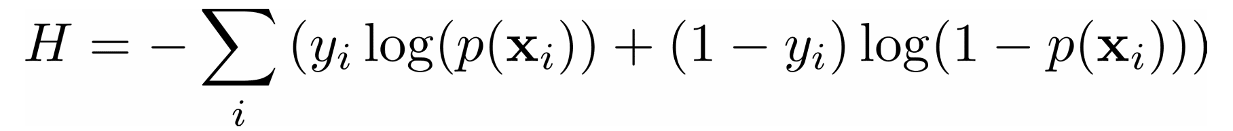
Classification problems
In a classification problem, the outputs 𝑦 are categorical, often either 0 or 1. For example, you might try to predict whether an email is spam or not. In the case of binary outputs, it’s convenient to minimize the cross-entropy function that also depends on the actual outputs 𝑦ᵢ and the corresponding predictions 𝑝(𝐱ᵢ):

Slide 8

Logistic Regression
In logistic regression, which is often used to solve classification problems, the functions 𝑝(𝐱) and 𝑓(𝐱) are defined as the following:
Again, you need to find the weights 𝑏₀, 𝑏₁, …, 𝑏ᵣ, but this time they should minimize the cross-entropy function.

Slide 9
Gradient of a Function: Calculus Refresher
In calculus, the derivative of a function shows you how much a value changes when you modify its argument (or arguments).
Derivatives are important for optimization because the zero derivatives might indicate a minimum, maximum, or saddle point.
The gradient of a function 𝐶 of several independent variables 𝑣₁, …, 𝑣ᵣ is denoted with ∇𝐶(𝑣₁, …, 𝑣ᵣ) and defined as the vector function of the partial derivatives of 𝐶 with respect to each independent variable: ∇𝐶 = (∂𝐶/∂𝑣₁, …, ∂𝐶/𝑣ᵣ). The symbol ∇ is called nabla.

Slide 10
Gradient of a Function: Calculus Refresher
The nonzero value of the gradient of a function 𝐶 at a given point defines the direction and rate of the fastest increase of 𝐶.
When working with gradient descent, you’re interested in the direction of the fastest decrease in the cost function.
This direction is determined by the negative gradient, −∇𝐶.

